Slide 1
Sprint 2
Members: Aldo Jaramillo, Jeremy Oliver, Ryan Hiller,
Ben Mettlach, Tate Wongweeratorn, Justin Treece,
Wesley Kramer

Slide 2


Slide 3
Refresher
Requirements
Login page
Schedule Scanner
Google Maps API
Constraints
Working with IT

Slide 4
New Constraints
Constraints
Implementing the schedule scraper (JSX)
Security concerns (Student’s emails and addresses)
Lack of experience with Express

Slide 5
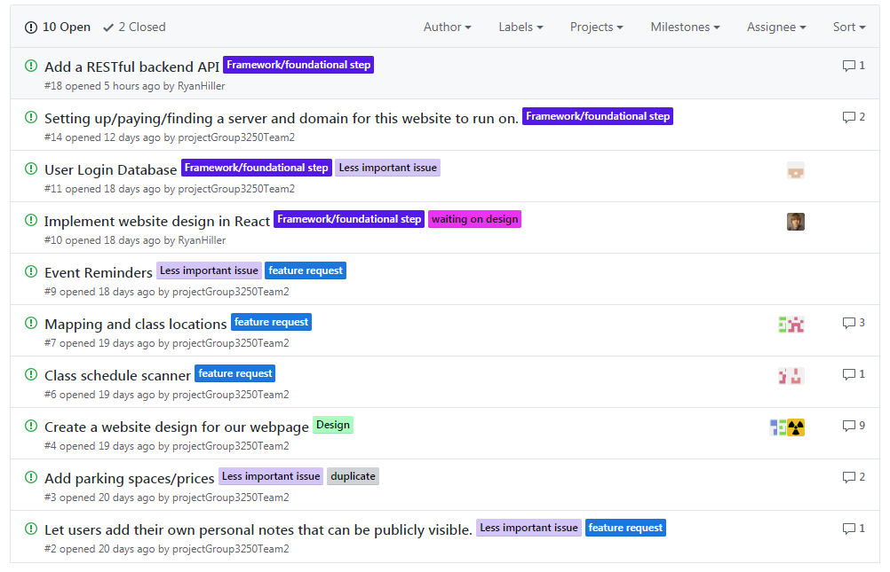
New Requirements

Slide 6
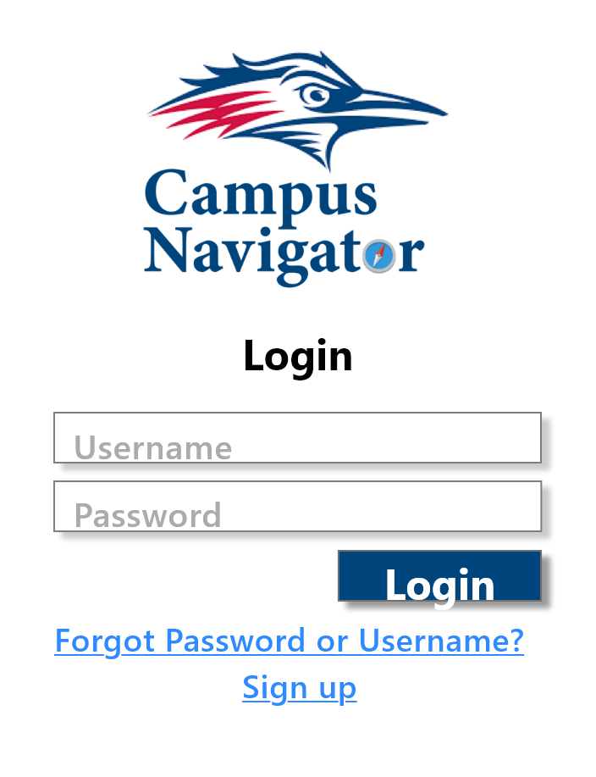
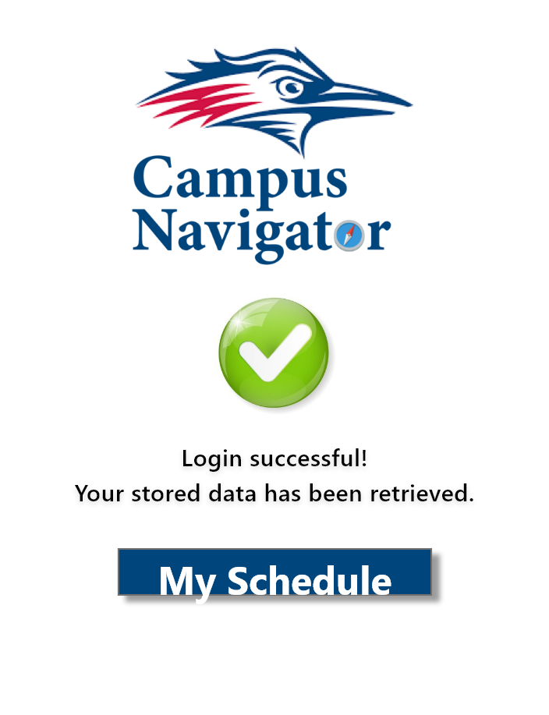
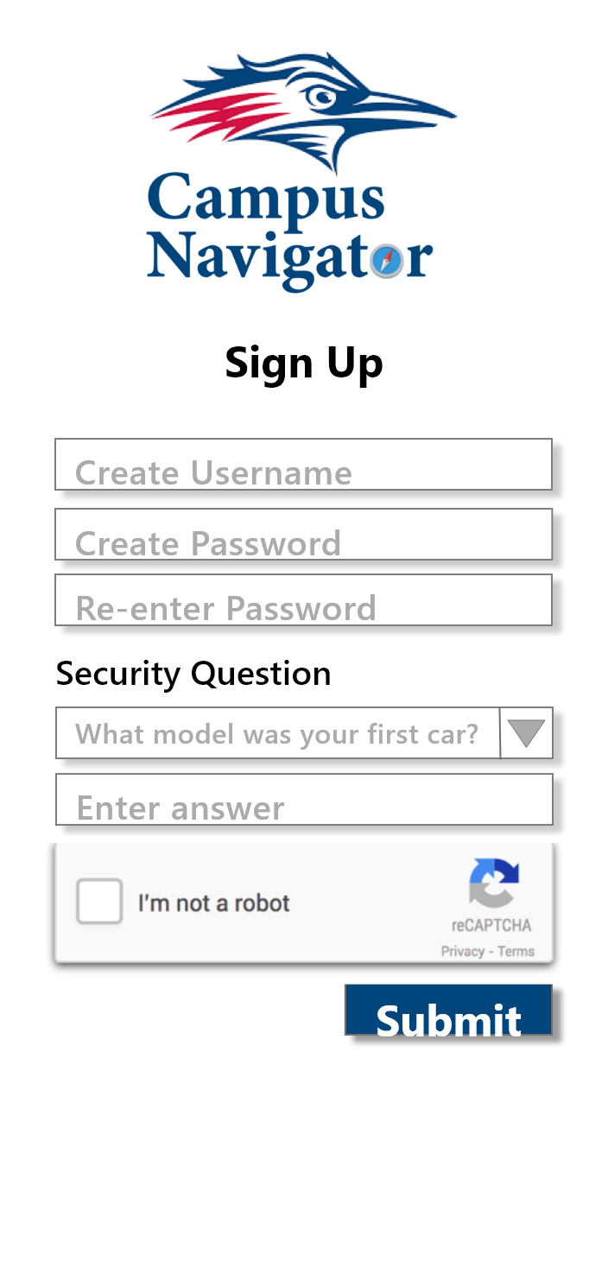
And a demo!

Slide 7
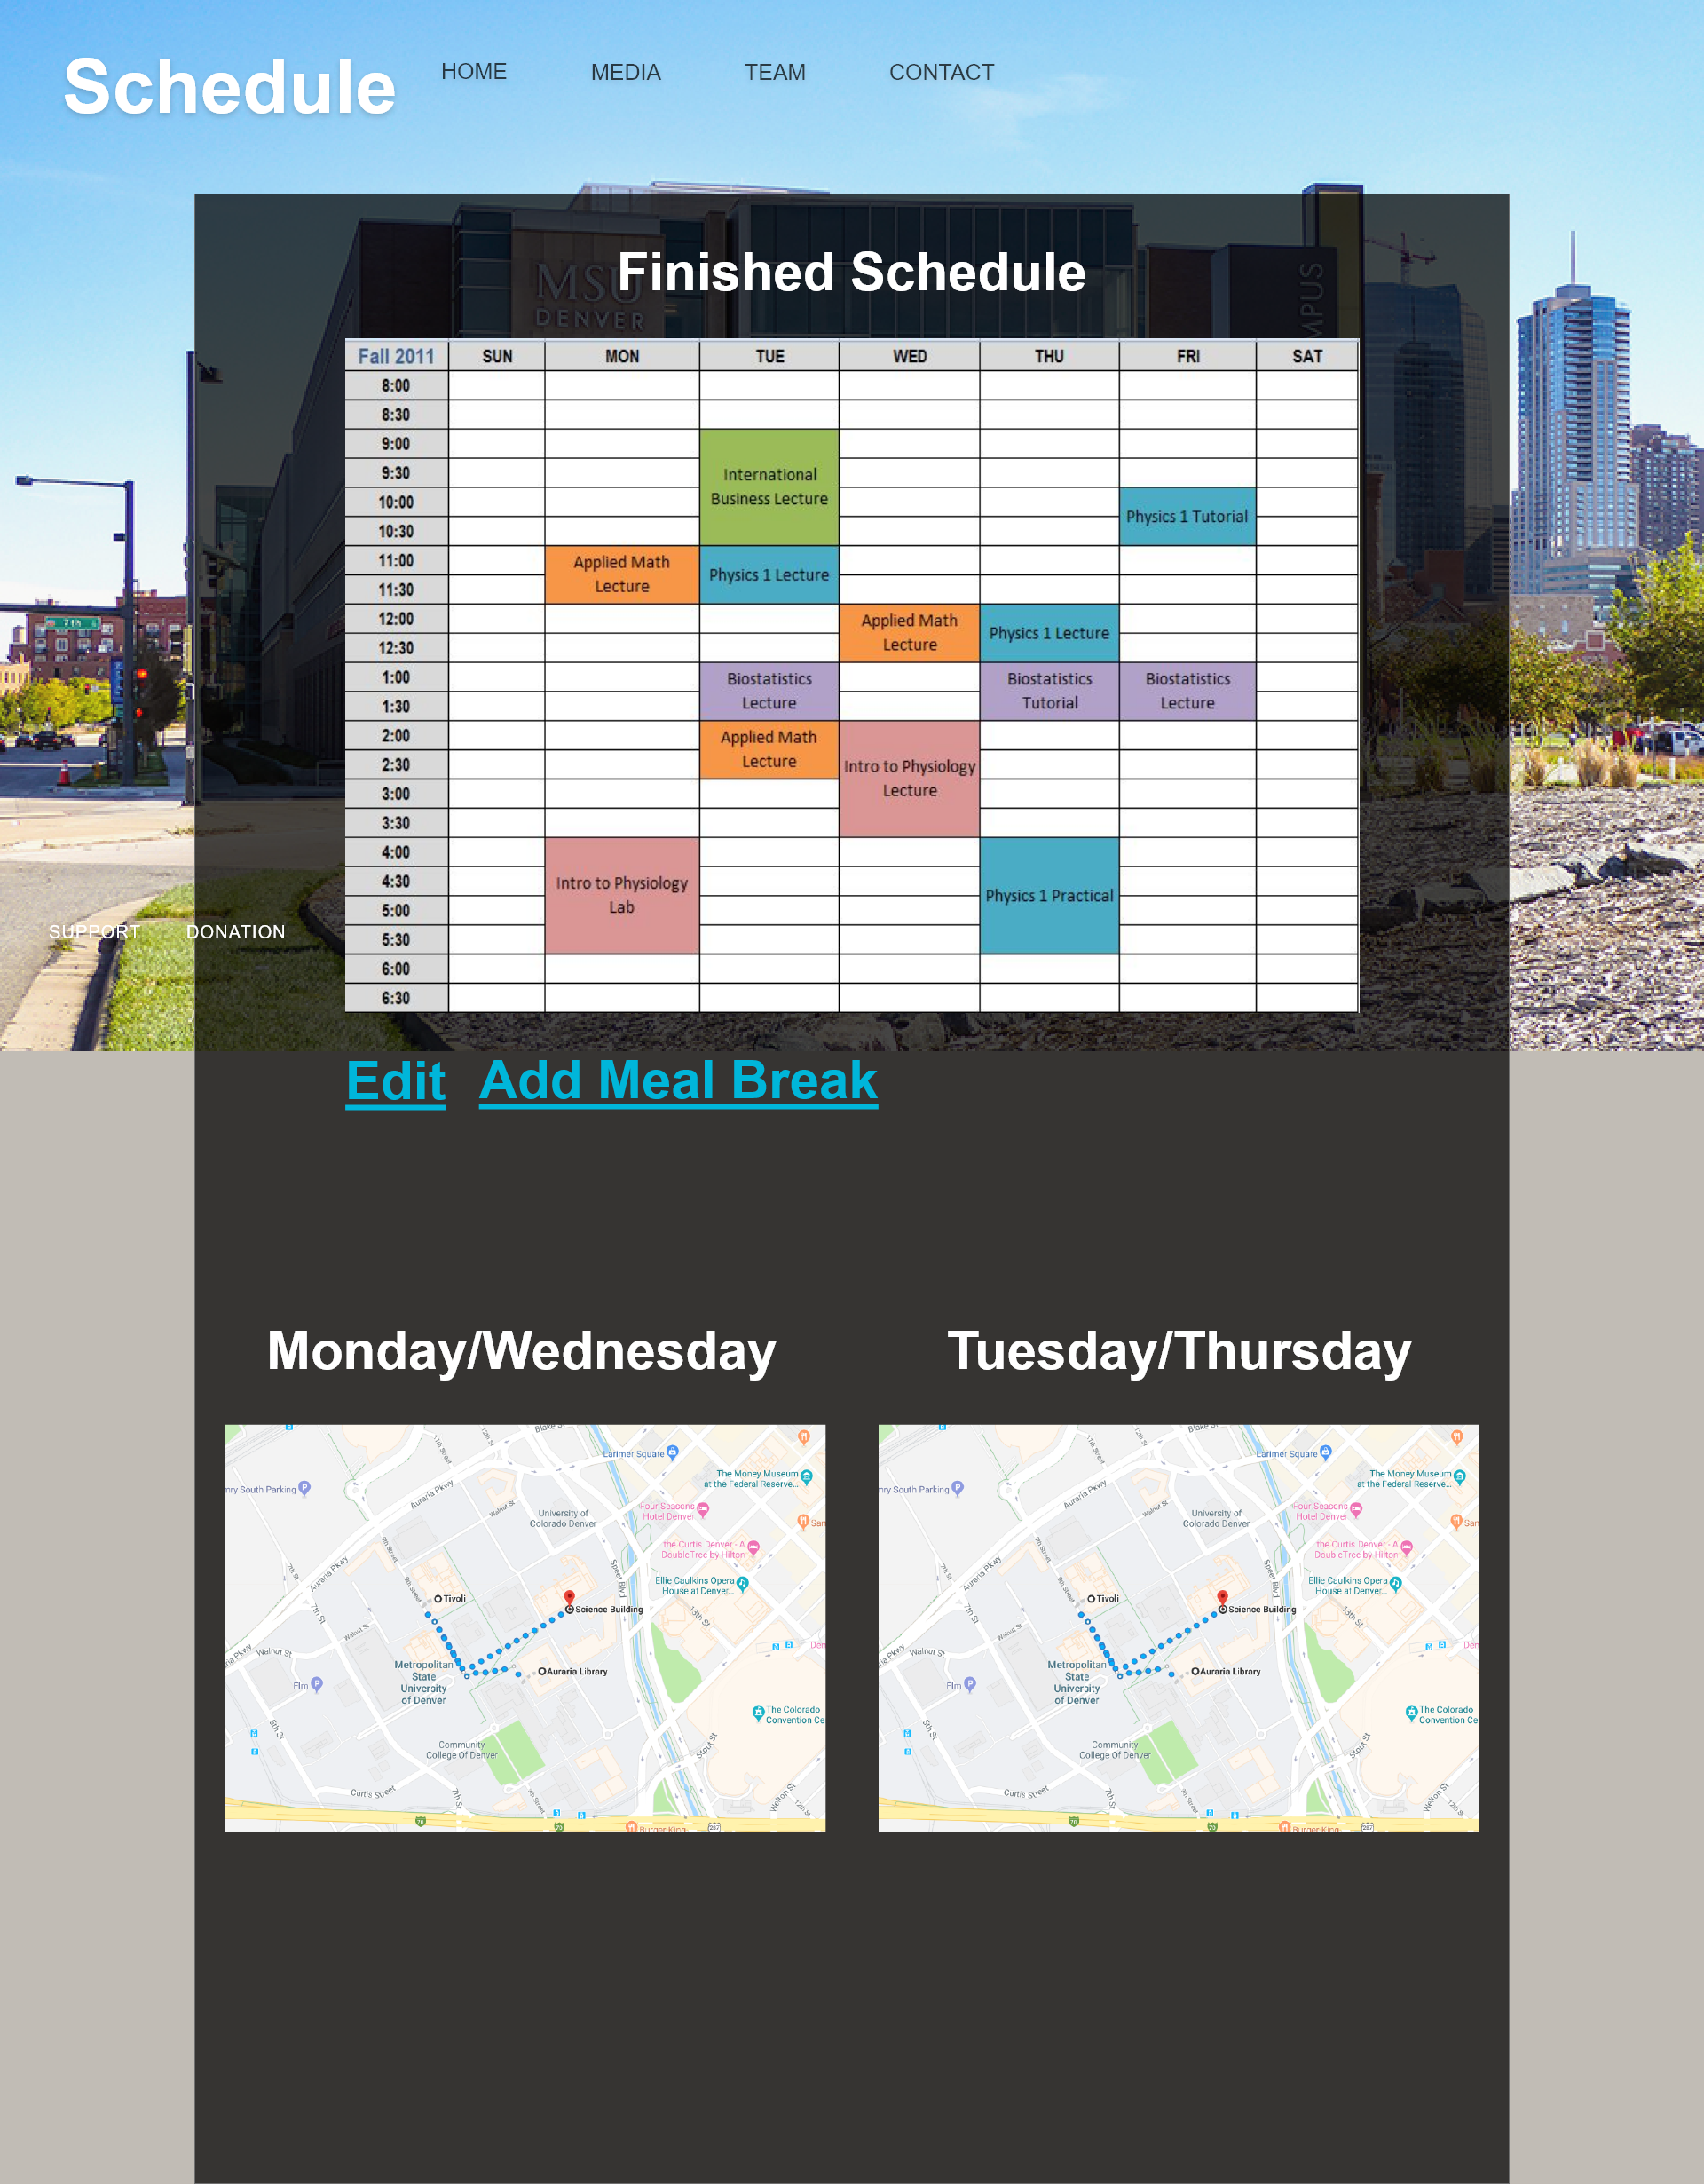
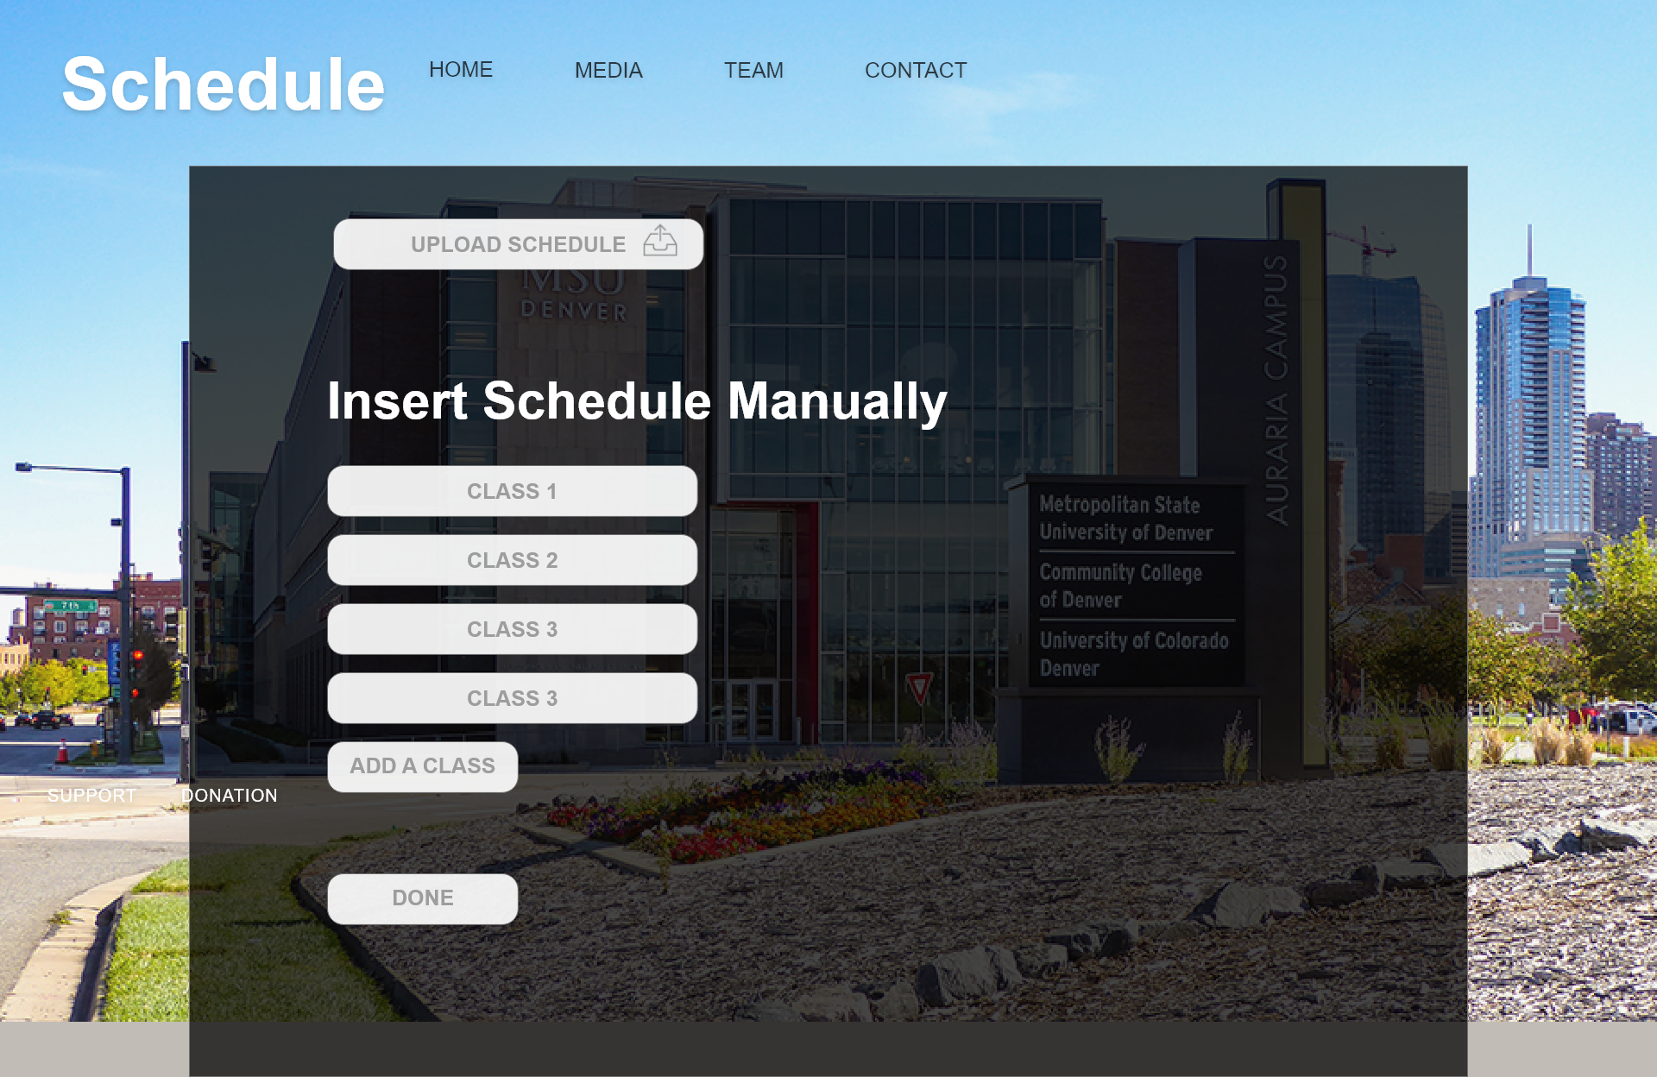

Slide 8
Justin Treece: 18%
Ryan Hiller: 17 %
Jeremy Oliver: 15%
Tate Wongweeratorn: 14 %
Aldo Jaramillo: 14%
Ben Mettlach: 12%
Wesley Kramer: 10%

Slide 9
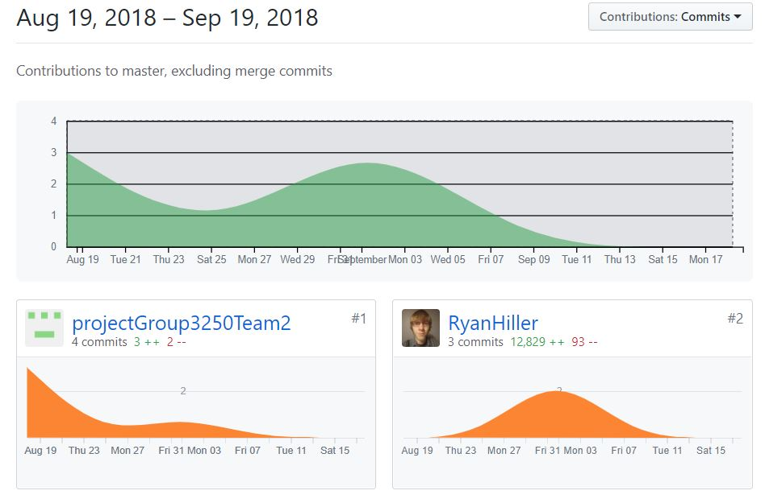

Slide 10
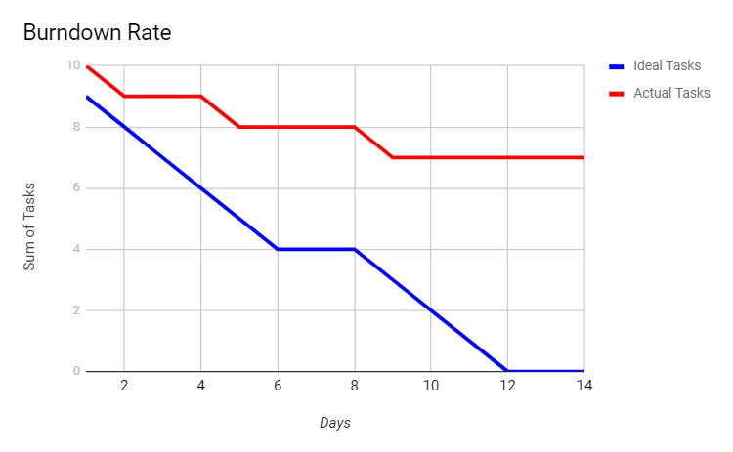

Slide 11


What have we learned?
The MERN stack (especially React)
GitHub / GitBash / Git
How to communicate between React,
Express, and Node.js

Slide 12
How to stay in contact
How to share research as a group
How to function when we miss a meeting
*We’ll continue our habits of good communication and sharing research.
*We’ll try not to lose sight of the end goal.

Slide 13
Thank you for your time.
Questions?

